Slide 1

Welcome

Slide 2
Business Process Automation
Day – 04
Part 1
:p

Slide 3
What we will do today
User Interface Automation

Slide 4
User Interface Automation
Automating User interfaces (UIs) is one of the most important features that differentiate RPA from other automation technologies.
This will be an introduction to the key UI Automation concepts and some practice exercises with both the modern and classic design experiences.
We will divide this in three modules:

Slide 5
Introduction to UI Automation
What UI Automation is.
Key concepts of UI Automation.
The difference between the modern and the classic design experiences.
How to change the design experience in Studio.
Configure a default design experience at Studio level for all new automation projects.

Slide 6
UI Automation with the Modern Design Experience
Selection Option Screen in the modern design experience.
Input and Output activities in the modern design experience.
Input method and activities in the modern design experience.
Output method and activities in the modern design experience.
UI synchronization activities in the modern design experience.

Slide 7
UI Automation with the Classic Design Experience
Introduction to classic design experience.
Input methods and activities in the classic design experience.
Output methods and actions in the classic design experience.
UI synchronization activities in the classic design experience.

Slide 8
What we will learn today
1. Explain what is UI Automation.
2. Explain the key elements of UI Automation with UiPath Studio.
3. Differentiate between the modern and the classic design experiences in Studio.
4. Change the design experience in Studio based on the automation requirement.

Slide 9
What Is UI Automation?
User interface or graphical user interface automation (UI Automation) refers to the process of interacting with graphical elements within applications by simulating mouse and keyboard controls.
Just as human users use applications through activities such as clicking, typing, or selecting text, UiPath Robots can be configured in UiPath Studio by RPA Developers to perform the same tasks faster and error-free.

Slide 10
How should you view UI Automation?
Considering that robots will perform actions in application user interfaces (UIs) just as humans would, RPA Developers will need to configure each action in a logical, sequential path.

Slide 11
Scenario: Get the transaction number from the 'Double UI' application.
Let's consider that our goal is to automate a simple task that enters data in the Double UI application, clicks the Accept button, and gets the transaction number.
To do this, we need to consider the state of the application. We want to start from, how a human user would go about executing the steps, and then break down the task into each step. As a first step, let's see the human path.

Slide 12
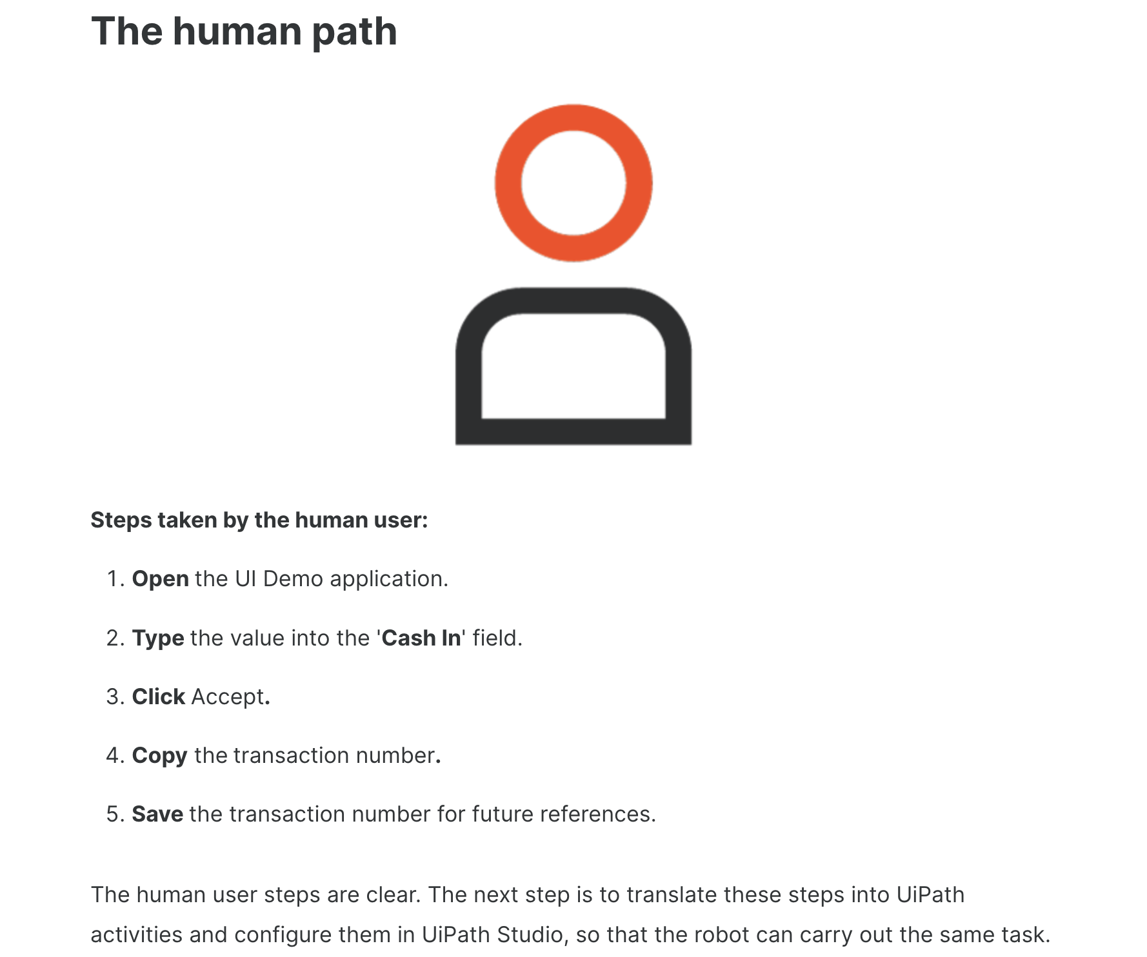

Slide 13
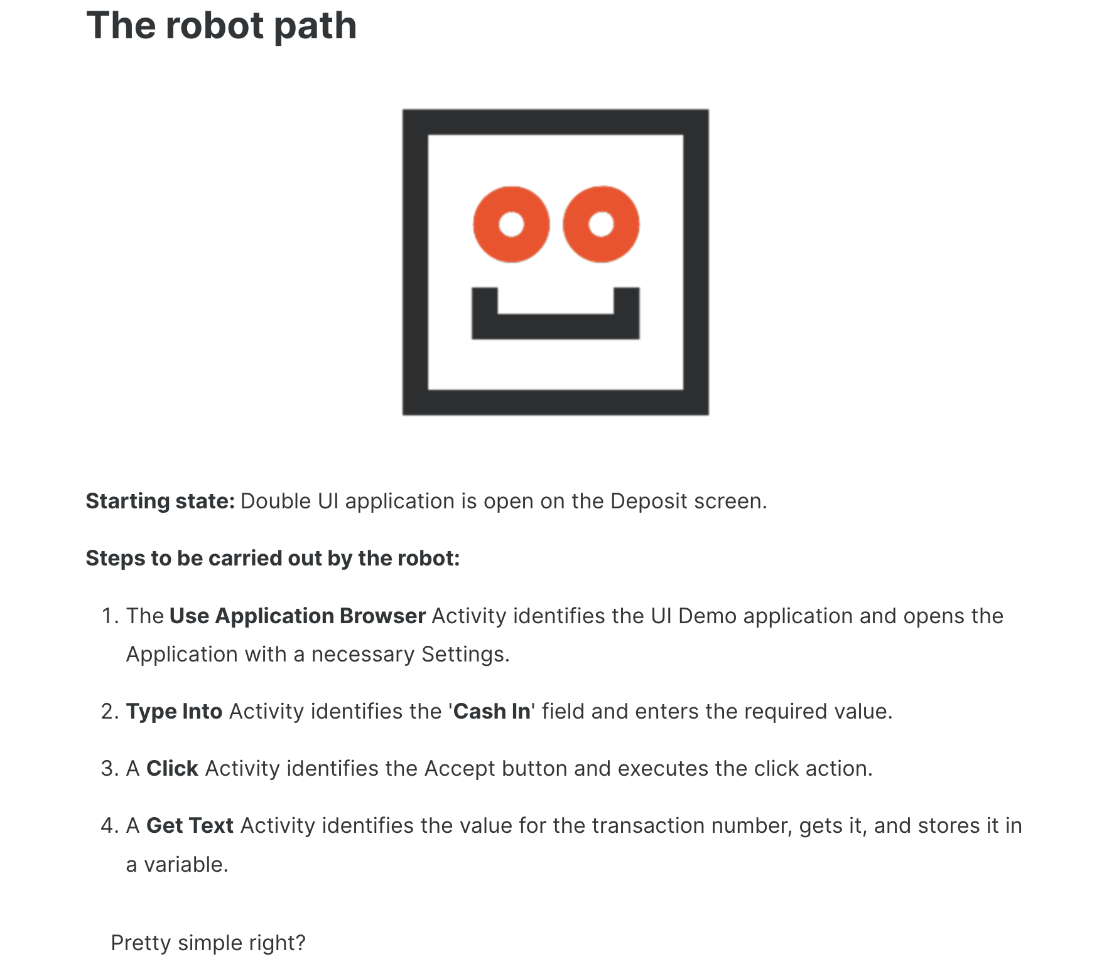

Slide 14
Main takeaways
UI automation is the process of automating application user interfaces by simulating human input and output actions through specific UI activities.
The first step in automating UIs is understanding the logical sequence of steps that a human user would take. The second step consists in translating these steps into UiPath Studio activities and configuring them.
The complexity of the UI or of the application is irrelevant. All desktop applications can be automated by using universal or application tailored activities.

Slide 15
How Does UI Automation Work?
A few questions should be appear like:
"What kind of activities can I use?",
"How does the robot know what elements to target?"
"What options do I have to control the execution of an activity?".

Slide 16
UI Automation is built upon seven key concepts. These are:
UI Automation activities
Activity properties
Targeting methods
Input and output methods
Recorders and Scraping Wizards
The object repository
AI Computer Vision

Slide 17
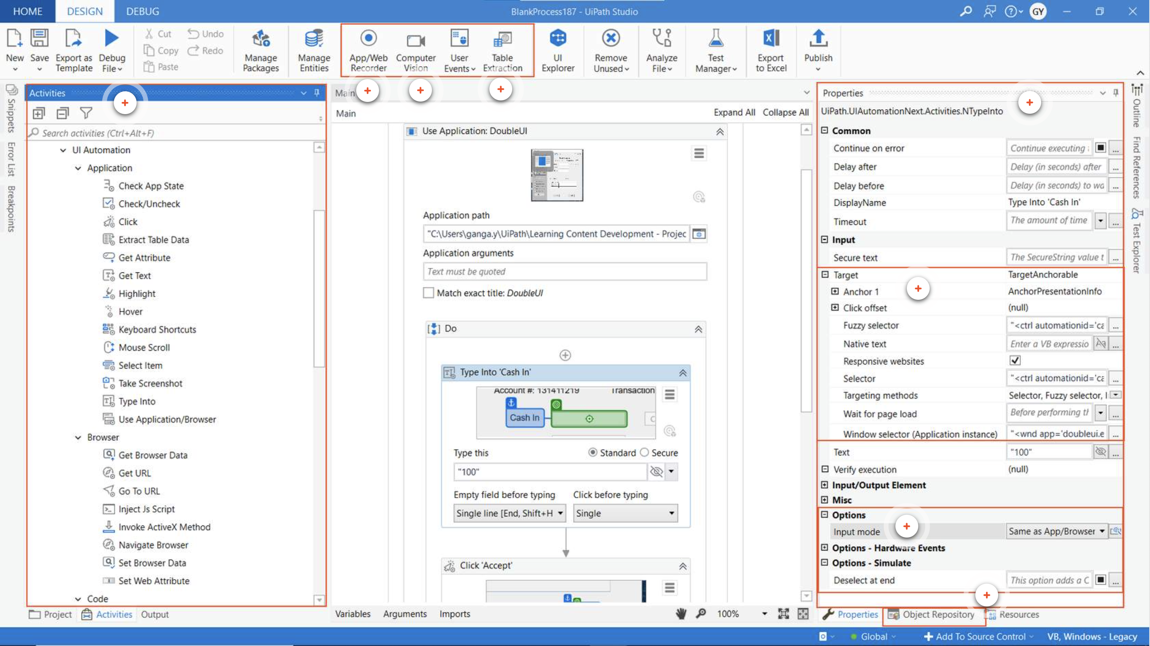

Slide 18
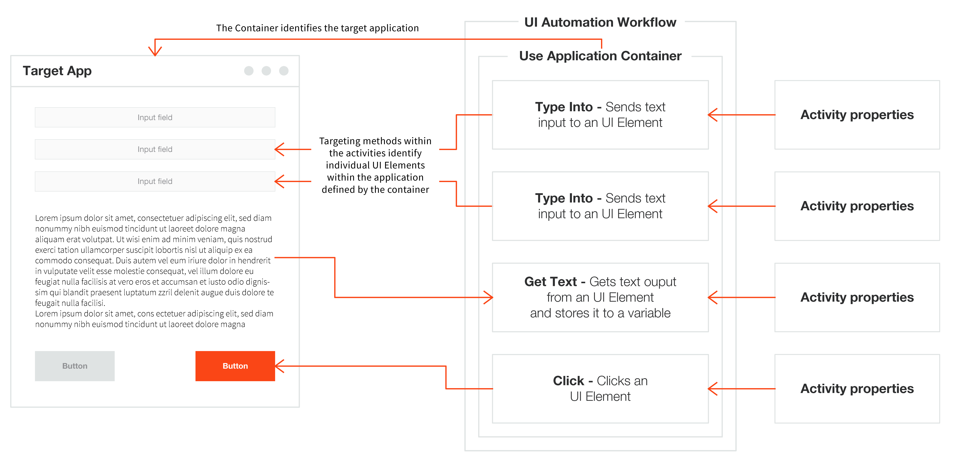

Slide 19
UI Automation activities
UI Automation activities let developers quickly write instructions for the Robot to interact with the interfaces of various applications. Activities can be split into the following categories:
Containers - These are activities that identify the browsers or apps the process needs to interact with. All activities included within a Container will execute on the same application. Some examples are Open Browser, Attach Browser, Open Application, or Use Application/Browser.
Input Activities - These activities send input to UI elements. They can be used to click, check, type into, send hotkeys, and so on.
Output Activities - These activities get information from GUI Elements. They can instruct the Robot to get the text by using various methods, get structured data, or get the UI Elements containing images.
Synchronization Activities - They help you create triggers based on the UI behavior, thus enabling the Robot to execute certain actions when specific events occur on a machine.

Slide 20
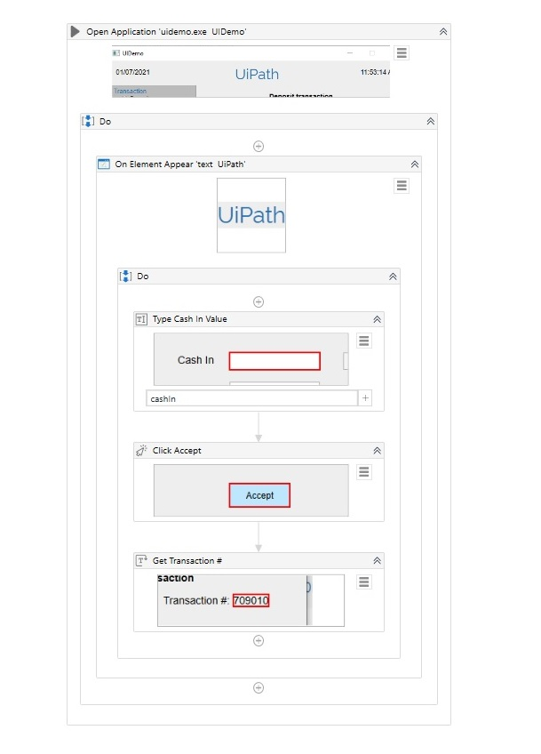

Slide 21
Activity properties
Just like for other types of activities, properties determine how the robot performs an action. They can be found in the Properties panel. UI Automation activities have specific sets of properties depending on the type of activity. Here are a few examples of common properties:

Slide 22
Property | What it does
DelayAfter/DelayBefore | How many milliseconds the robot waits before or after executing the activity.
ContinueOnError | Will an exception encountered while executing the activity be thrown or ignored? For example, if the element isn't found, will robot throw an error and stop the execution, or will it ignore it and continue?
Target | Provides several properties related to identifying the target UI Element.
Timeout (milliseconds) | How many milliseconds will the Robot try to perform an action on an UI element.
SendWindowsMessages/Simulate Type | What input method do we use for input activities.
Output | It Stores the output of the activity in the form of variables.

Slide 23
Targeting methods
Targeting methods are a subset of Properties. They provide several ways to identify the UI element the Robot will be interacting with.
The key targeting methods are:
Selectors
Fuzzy Selectors
Image
Native Text
You'll learn more about these later

Slide 24
Input and output methods
As we've discussed already, every time we insert data into an application, or we send a command to a system to produce a change (or to continue), we perform an input action.
Output actions are used to extract data (in general, as text) from a UI element.
Output methods are what enables output actions to extract data from UI elements.

Slide 25
Input and output methods
UiPath provides several methods to perform input and output actions. These methods control several important aspects of our automation:
How fast will the action be performed?
Can the action run on a background or a hidden window?
Does it interfere with the user?
Is it compatible with all apps?
Different methods are available for input and output activities.

Slide 26
Input methods
Hardware Events
SendWindowMessages
Simulate
ChromiumAPI

Slide 27
Hardware Events
Clicking: the mouse cursor moves across the screen.
Typing: the keyboard driver is used to type individual characters.
Compatible with all applications.
Does not work in the background.
The attended user cannot touch the mouse or keyboard during the automation.

Slide 28
SendWindowMessages
Replays the window messages that the target application receives when the mouse/keyboard is used.
Works in the background.
Users can work on other activities during the execution of the automated processes.

Slide 29
Simulate
Uses the technology of the target application (the API level) to send instructions.
It is the fastest targeting method.
Works in the background.
Users can work on other activities during the execution of the automated processes.

Slide 30
ChromiumAPI
It is a browser automation input method based on the Devtools protocol.
It allows direct communication with the browser, in turn fewer communication channels, and thus improved automation reliability.
Works in the background.
Users can work on other activities during the execution of the automated processes.

Slide 31
Output methods
Full Text
Native
OCR

Slide 32
Full Text
The FullText method is the default method and good enough in most cases.
It is the fastest, it can extract hidden text, it has 100% accuracy, and can work in the background.

Slide 33
Native
The Native method is compatible with applications that use Graphics Design Interface (GDI),
The Microsoft API used for representing graphical objects.
It doesn’t extract hidden text and it cannot work in the background; and just like FullText, it doesn’t support virtual environments.

Slide 34
OCR
OCR (or Optical Character Recognition) is the only output method that works with virtual environments and with “reading” text from images.
Its technology relies on recognizing each character and its position.
On the other hand, it cannot work in the background, it cannot extract hidden text, and its speed is by far the lowest.

Slide 35
Recorders and Scraping Wizards
Recording is an important part of UiPath Studio, that can help you save a lot of time when automating your business processes.
This functionality enables you to easily capture a user’s actions on the screen and translate them into sequences.
These projects can be modified and parameterized so that you can easily replay and reuse them in as many other processes as you need.
Scraping Wizards helps to extract structured data from your browser, application or document to a database, .csv file or even Excel spreadsheet.

Slide 36
The object repository
The object repository ensures the management, reusability, and reliability of UI elements by capturing them as objects in a repository, sharable across projects.
It allows for creating and reusing UI taxonomies inside and across automation projects.
This is a more advanced feature we will learn more about later. (Maybe, if we have time !!)

Slide 37
AI Computer Vision
The AI Computer Vision activity package contains refactored fundamental UI Automation activities such as Click, Type Into, or Get Text.
The main difference between the CV activities and their counterparts is their usage of the Computer Vision neural network developed in-house by our Machine Learning team.
The neural network is able to identify UI elements such as buttons, text input fields, or check boxes without the use of selectors.
This is an advanced feature we will learn more about later. (Maybe !!)

Slide 38
Main takeaways
The key concepts of UI Automation in UiPath are:
UI Automation Activities
Activity Properties
Targeting Methods
Input and Output Methods
Recorders
The Object Repository
Computer vision

Slide 39
Recap
UI Automation Activities - Activities can be containers, input activities, output activities or synchronization activities.
Activity Properties - Properties determine how the Robot performs an action. They can be found in the Properties panel.
Targeting Methods - They provide several ways to identify the UI element the Robot will be interacting with.
Input and Output Methods - Define the type of technology used in interacting with UI elements. Output methods are used to extract data (in general, as text) from a UI element. The technology used by Input methods is different than the one used in Ouput methods.
Recorders and Wizards - This functionality enables you to easily capture a user’s actions on the screen and translates them into sequences.
The Object Repository - The Object Repository ensures the management, reusability, and reliability of UI elements by capturing them as objects in a repository, sharable across projects.
AI Computer Vision - Is able to identify UI elements such as buttons, text input fields, or check boxes without the use of selectors.

Slide 40

That’s it

Slide 41

Thanks

